Slide 1

Workers Supervision for Construction Safety
PHAM, Trung Kien DO, Van Quyet

Slide 2
Rundown
Overview
Objectives
Datasets
Methodology
Preliminary Result
References
Q&A

Slide 3
1 Overview

Slide 4
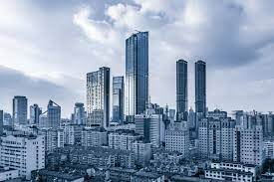
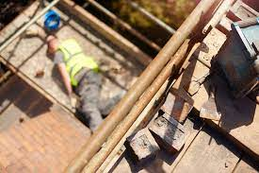
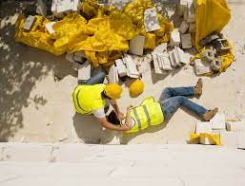
1. Overview
The construction industry grows significantly every year
# accidents in construction site also increases
Raise the need to enhance the safety. Our FOCUS: workers, wearing safety items

Slide 5
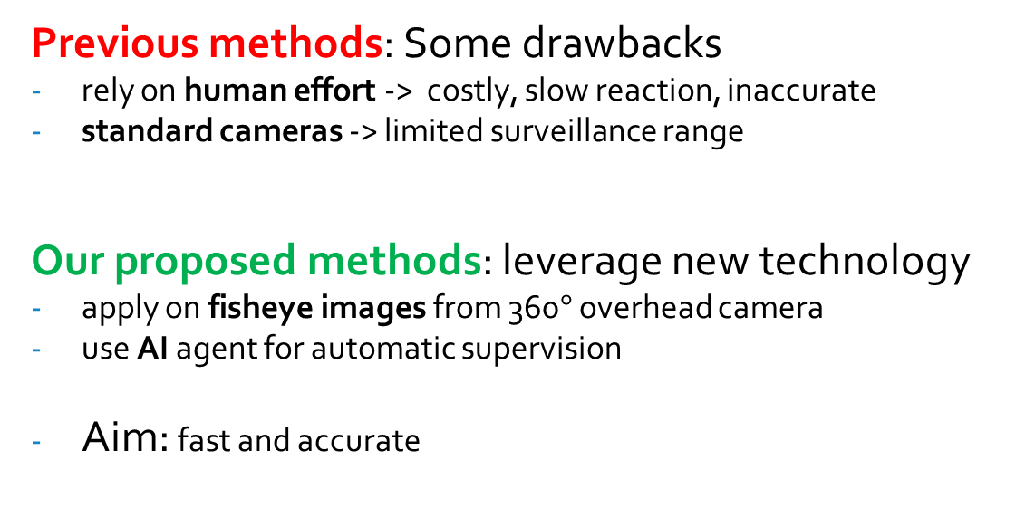
1. Overview
Previous methods: Some drawbacks
rely on human effort -> costly, slow reaction, inaccurate
standard cameras -> limited surveillance range
Our proposed methods: leverage new technology
apply on fisheye images from 360$°$ overhead camera
use AI agent for automatic supervision
Aim: fast and accurate

Slide 6
2 Objective

Slide 7
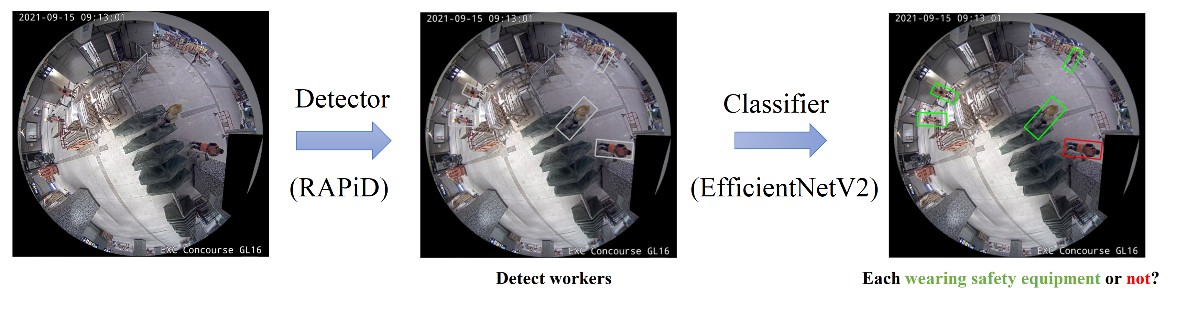
2. Objective
AI Model: Two major components:
a Multi-Person Detector to locate every worker inside input frames
a Binary Image Classifier to determine whether those workers are wearing all required types of safety equipment or not.

Slide 8
2. Objective
Evaluation and Expectation:
Detector (RAPiD):
use Average Precision (with IOU = 0.5) AP50 and F-measure
expected to reach performance as in original paper
Classifier (EfficientNetV2):
measure Accuracy, Precision and Recall
expected to reach 90% for each
Overall FPS: fast enough for instant reminder

Slide 9
3 Datasets

Slide 10
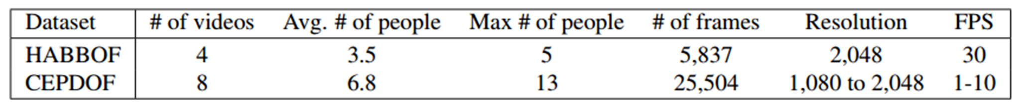
3. Datasets
for Detector:
HABBOF: Human-Aligned Bounding Boxes from Overhead Fisheye cameras
CEPDOF: Challenging Events for Person Detection from Overhead Fisheye image

Slide 11
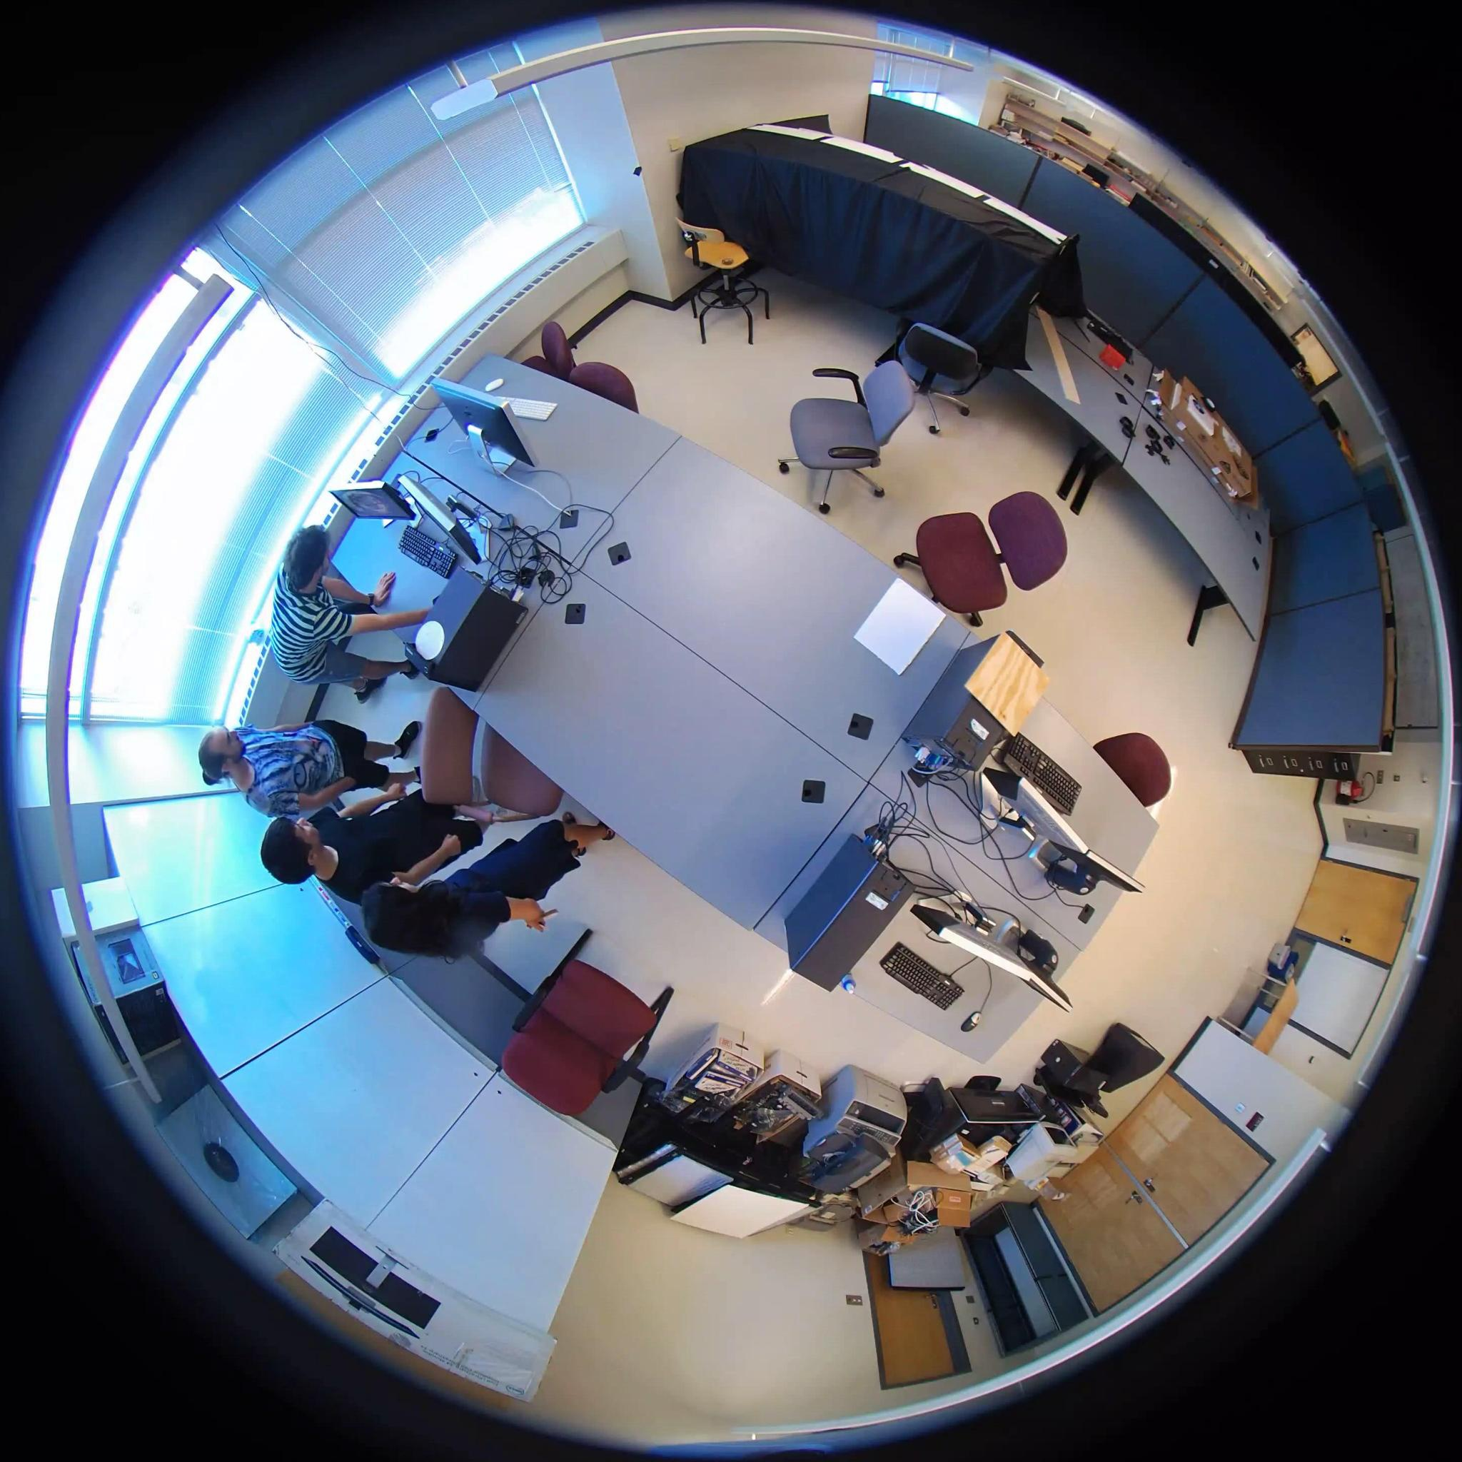
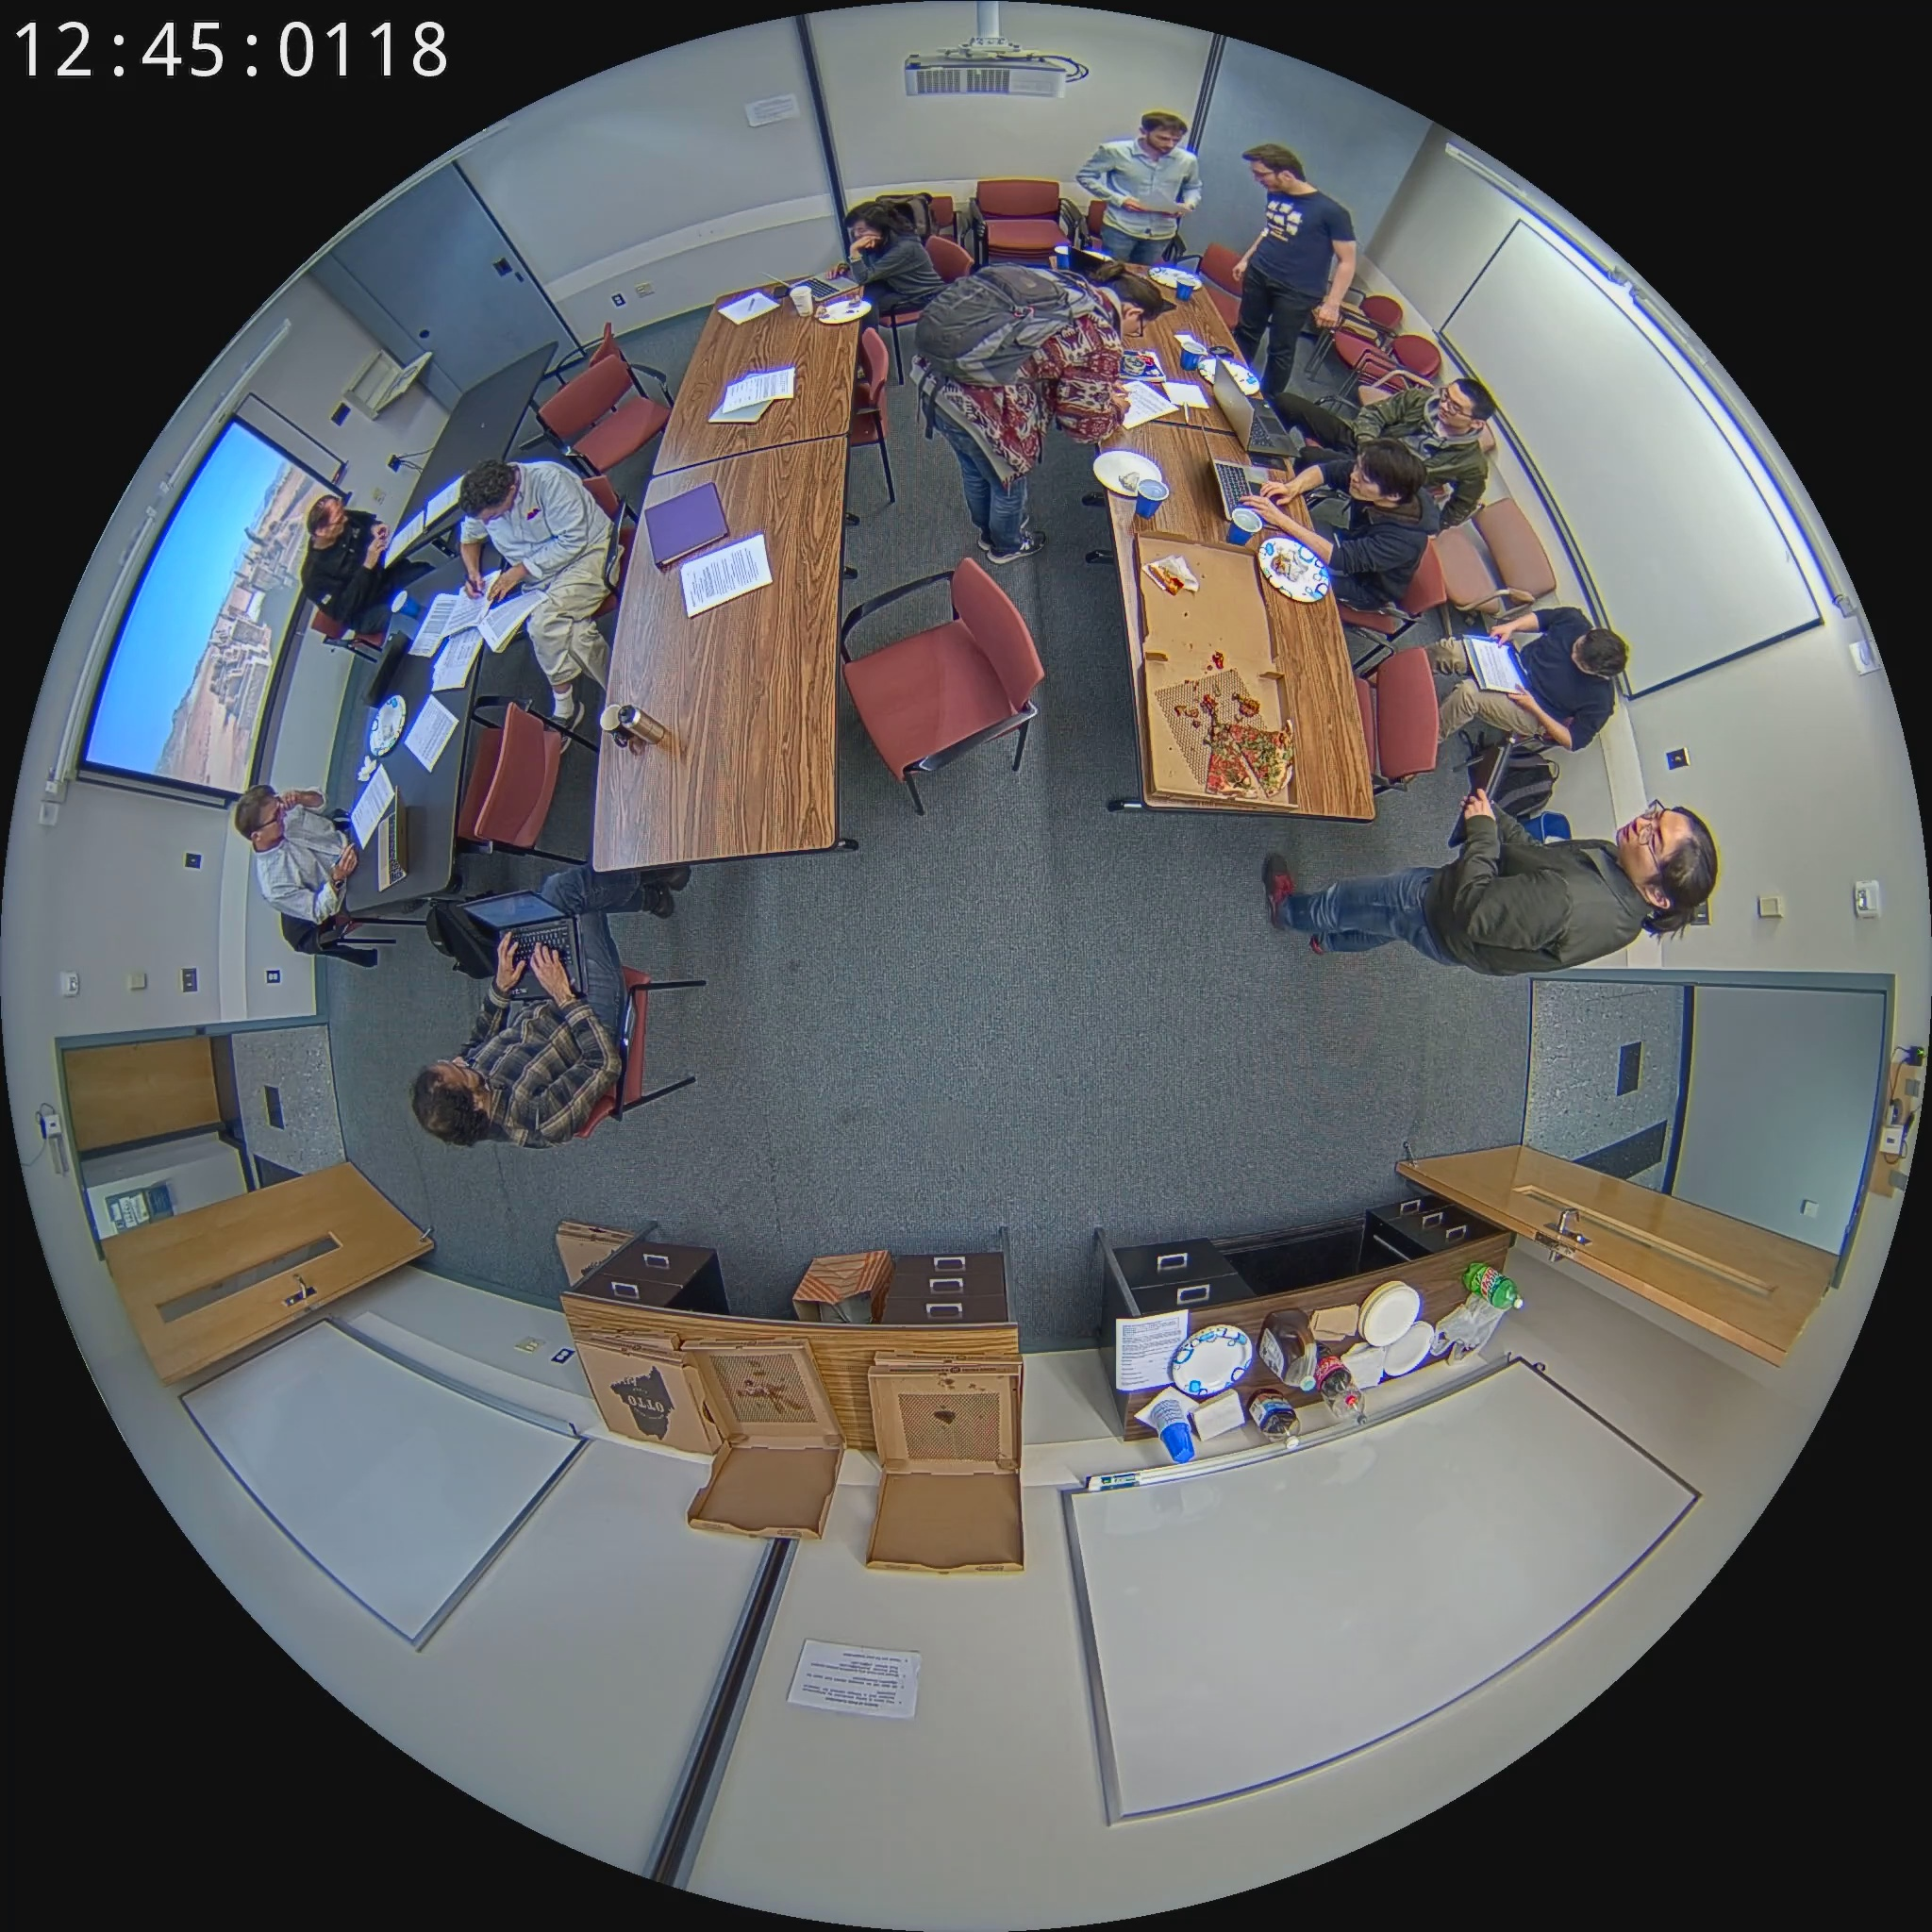
3. Datasets
for Detector: - image from HABBOF - image from CEPDOF

Slide 12
3. Datasets
for Classifier:
scraping, crawling, and cropping from open sources on the internet like Google Images and Shutterstock
focus on safety helmet and safety jacket:
consist of: - 20000 images for safety helmet case - still collecting for safety jacket case

Slide 13
4 Methodology

Slide 14
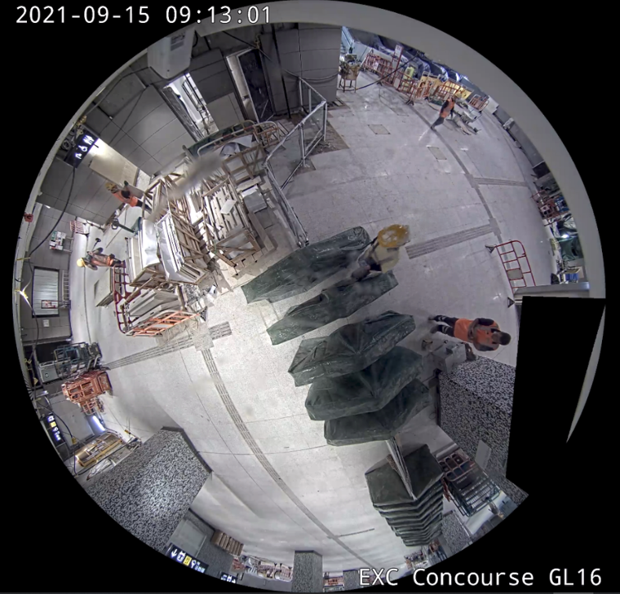
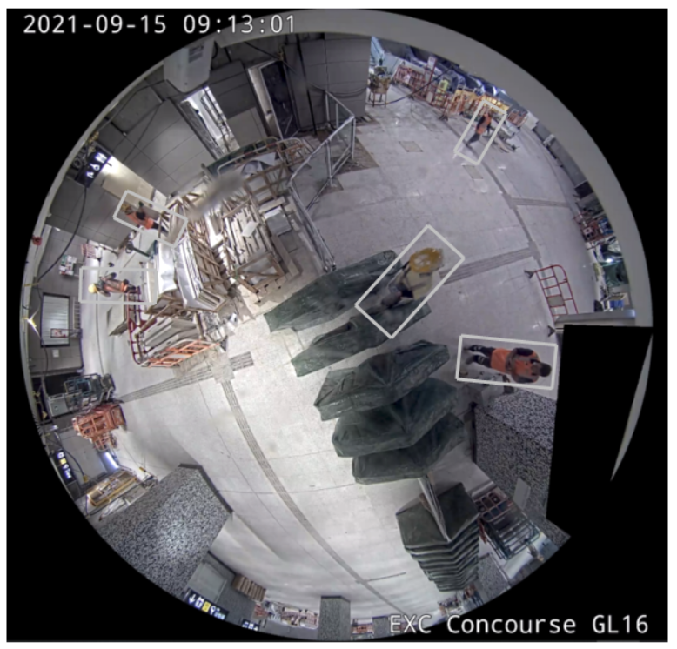
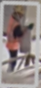
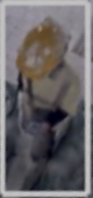
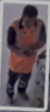
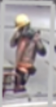
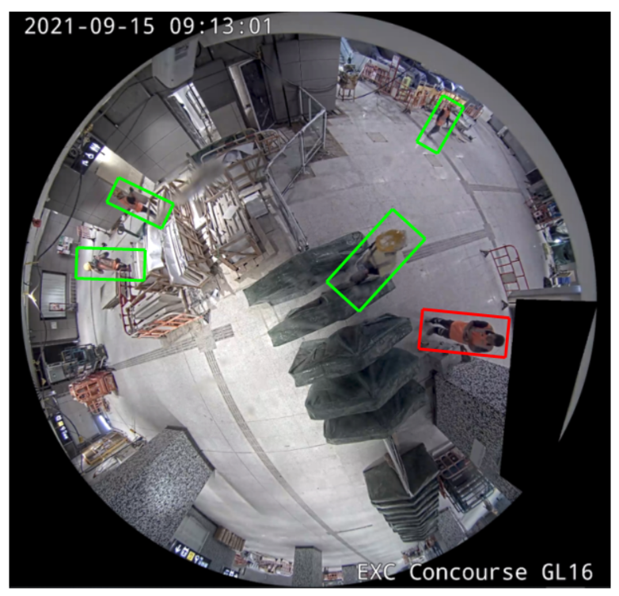
4.1 Pipeline
Binary Image Classifier
Multi-Person Detector

Slide 15
4.2 Multi-Person Detector
Binary Image Classifier
Multi-Person Detector
end-to-end model
arbitrarily-rotated bounding boxes
YOLO-based
RAPiD

Slide 16
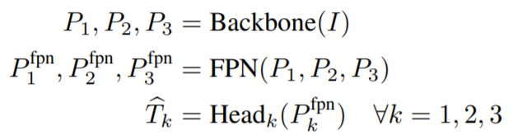
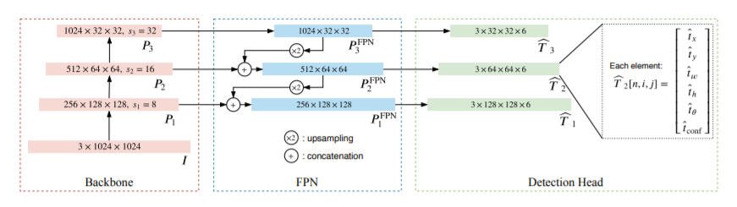
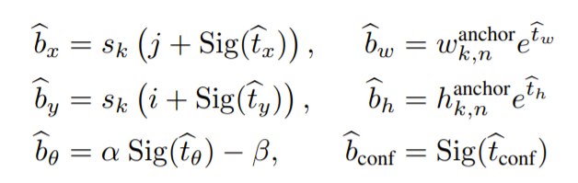
4.2.1 RAPiD Architecture
3
1
2
4

Slide 17
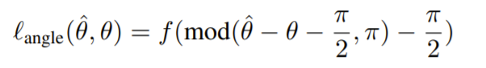
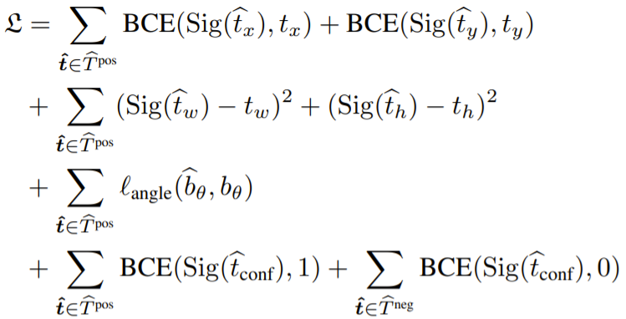
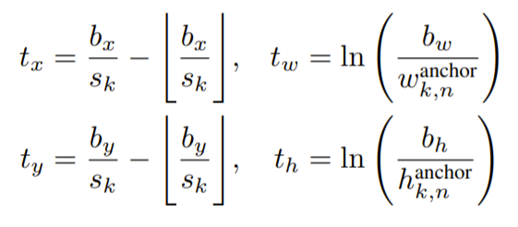
4.2.2 Why RAPiD ?
Continuous, periodic loss function for bounding-box angle
facilitates arbitrarily-oriented bounding boxes capable of handling a wide range of human-body poses

Slide 18
4.3 Binary Image Classifier
Binary Image Classifier
Multi-Person Detector
new family of CNN for classification
Neural Architecture Search
Progressive Learning
EfficientNetV2

Slide 19
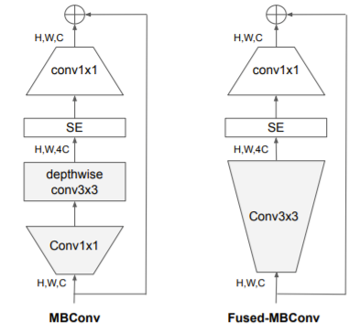
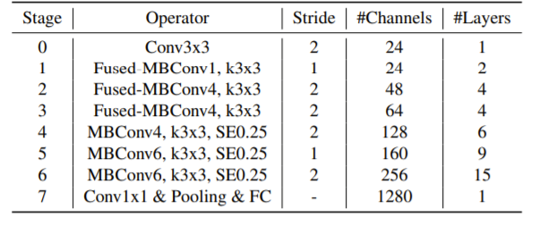
4.3.1 EfficientNetV2 Architecture
Full architecture of EfficientNetV2-S

Slide 20
4.3.2 Why EfficientNetV2 ?
6.8x smaller in size
Much faster in terms of training and inference time
Maintain similar or even higher classification accuracy

Slide 21
5 Preliminary Result

Slide 22
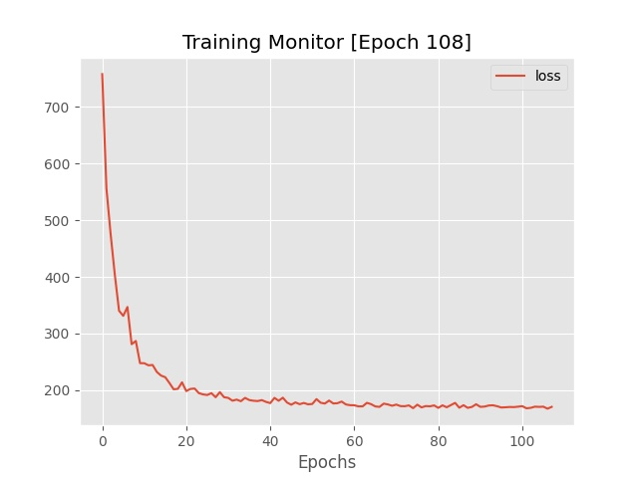
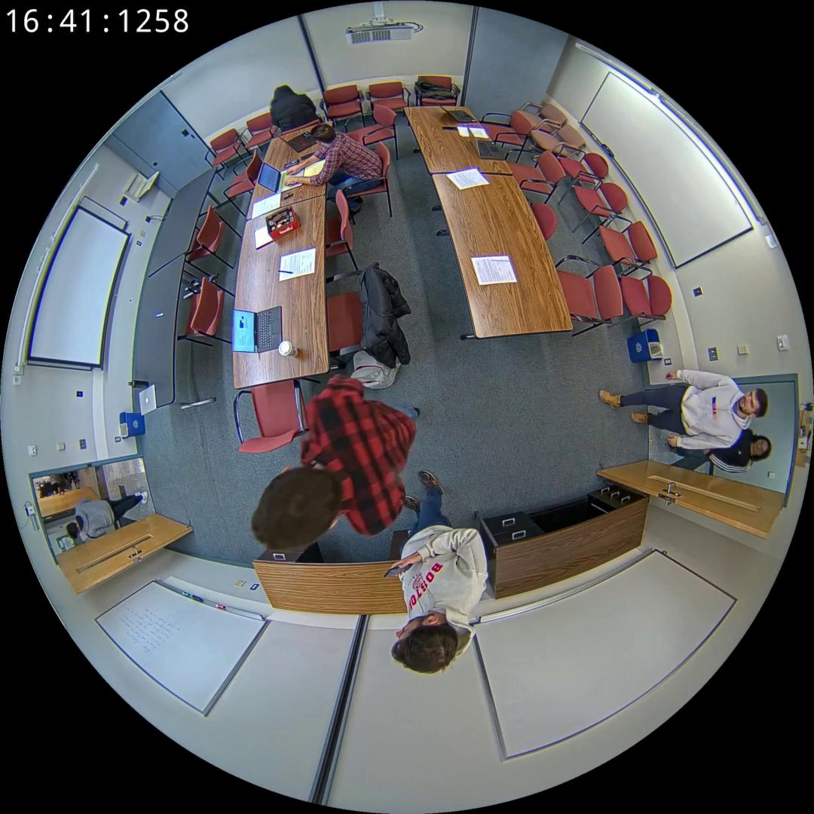
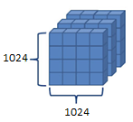

5.1 Multi-Person Detector Progress
$$✓$$
RAPiD architecture implementation
Training and Fine-tuning process ~80%
Resize
Normalize
Convert to tensor
Datasets: CEPDOF and HABBOF
Images + Annotations
Preprocessing process
Normalized tensors of
1024x1024 spatial resolution
Loss decreases over epoch
learning rate = 1e-4
momentum = 0.9
weight decay = 5e-4
Configuration
batch size = 16
epoch ~ 100 ≈ 200000 iterations
At first glance, detector is correctly implemented and trained
SGD Optimizer
Training hyperparameters

Slide 23

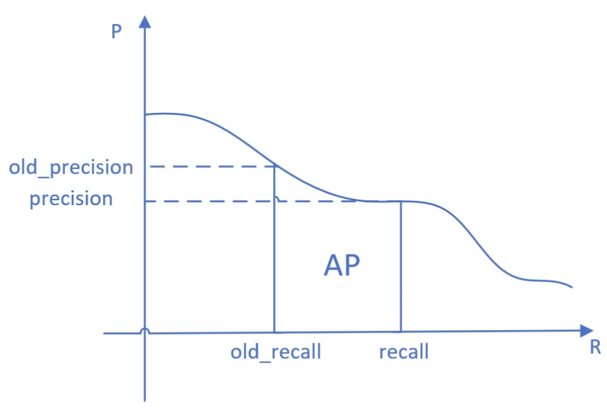
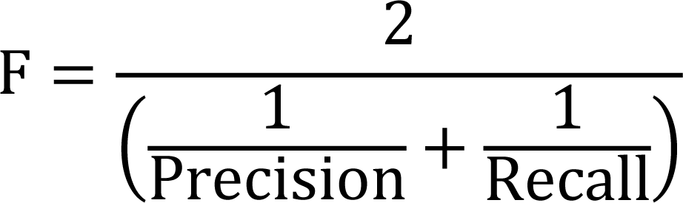
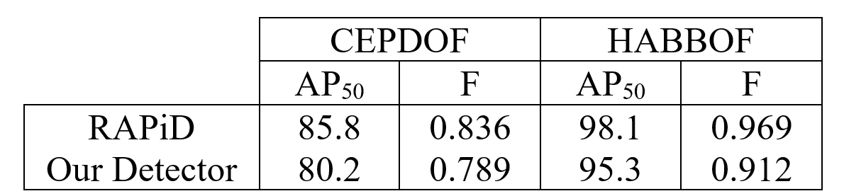
5.1.1 Quantitative Result
F-measure at a fixed 0.3 confidence threshold
Average Precision (AP) at IoU = 0.5 (AP₅₀)
Lower but close Can be improved !

Slide 24
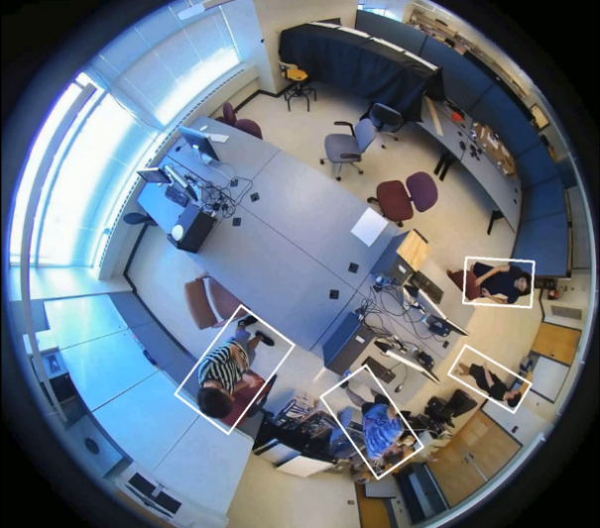
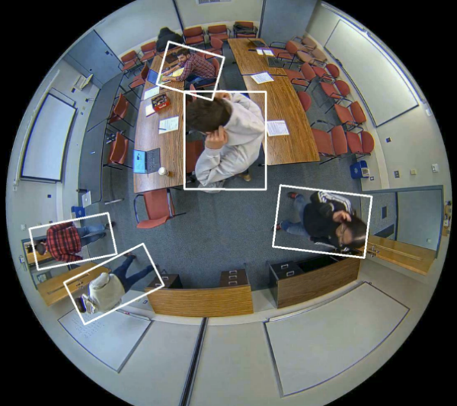
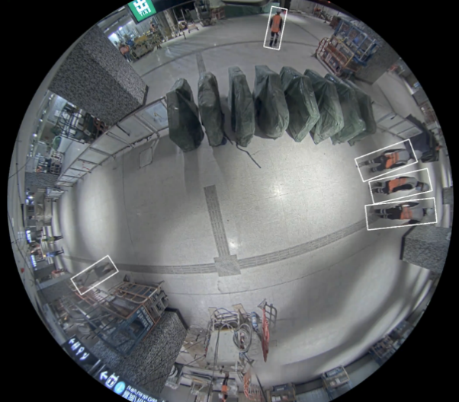
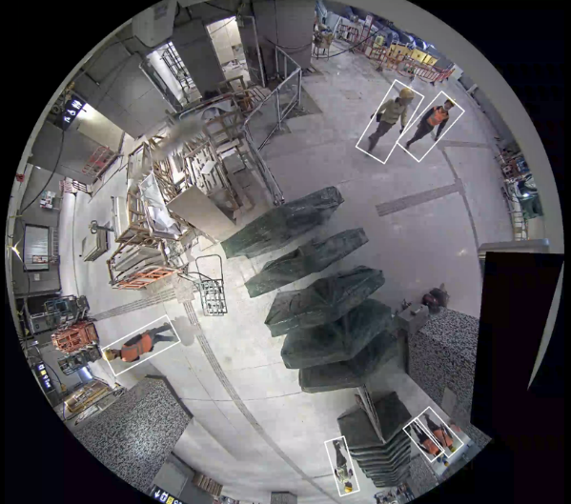
5.1.2 Qualitative Result

Slide 25
5.1.3 Further Improvement
Cross validating
Ex. using CEPDOF for training and HABBOF for validating
Adopting more complex augmentation methods to diversify dataset
Hyperparameters tuning
Different optimizers
…

Slide 26
5.1 Binary Image Classifier Progress
EfficientNetV2 architecture implementation ~80%
Training and Fine-tuning process
Limited resource 0%

Slide 27
United Nations Environment Programme. 2020 Global Status Report for Buildings and Construction: Towards a Zero-emission, Efficient and Resilient Buildings and Construction Sector. Nairobi, 2020.
CPWR – The Center for Construction Research and Training. Data Bulletin: Fatal Injury Trends in the Construction Industry, 02 2021
T. Anojan and C. S. A. Siriwardana. A Study to Investigate the Factors Affecting Construction Worker Performance. In 2021 Moratuwa Engineering Research Conference (MERCon), pages 13–18, 2021.
Z. Duan, M. Ozan Tezcan, H. Nakamura, P. Ishwar, and J. Konrad. Rapid: Rotation-aware people detection in overhead fisheye images. In 2020 IEEE/CVF Conference on Computer Vision and Pattern Recognition Workshops (CVPRW), pages 2700–2709, 2020.
M. Tan and Q. V. Le. Efficientnetv2: Smaller models and faster training.ArXiv, abs/2104.00298, 2021
6 References

Slide 28
Thanks for Listening ! QA

